Slide 1

Welcome to the SAPPHIRE Class

Slide 2
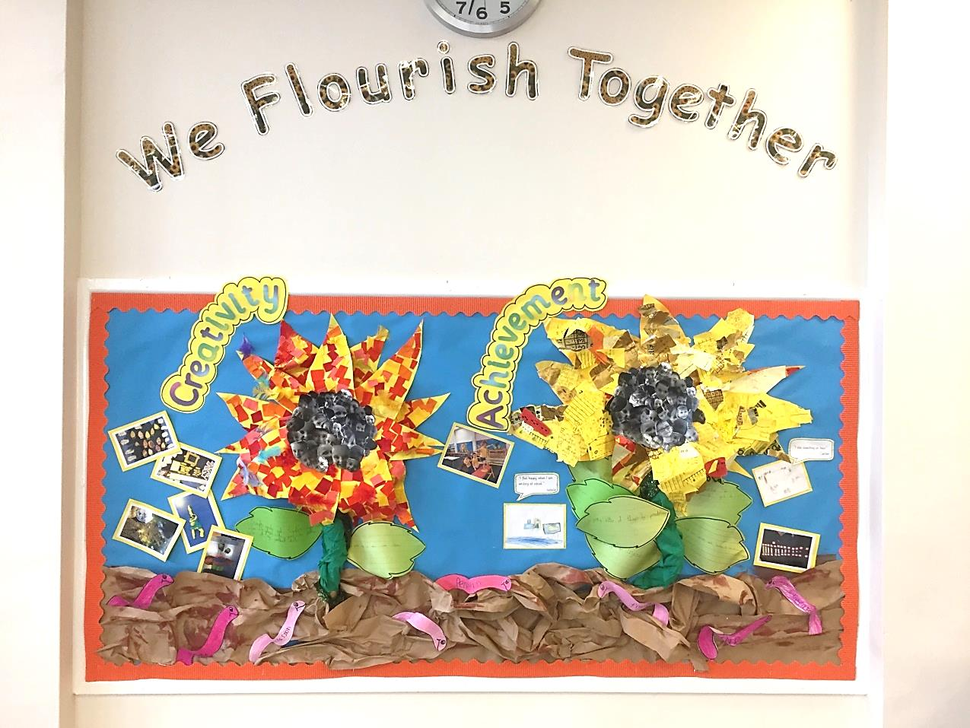
Our vision:
Achieving and growing together
“We are the seeds. Our school is the good ground which provides everyone with all they need to grow and achieve.”

Slide 3
Respect
Perseverance
Achievement
Notes:
A curriculum equation

Slide 4
School rules
Keep hand, feet and objects to ourselves
Use quiet, calm voices (no bad language)
Always follow teacher instructions
Care for the school environment

Slide 5
Attendance and punctuality
School begins at 8.45am for all children
Breakfast clubs runs from 7.30am if needed and costs £2 per morning
Children should be at school every day and on time
Good attendance and punctuality sets good habits for the future.

Slide 6
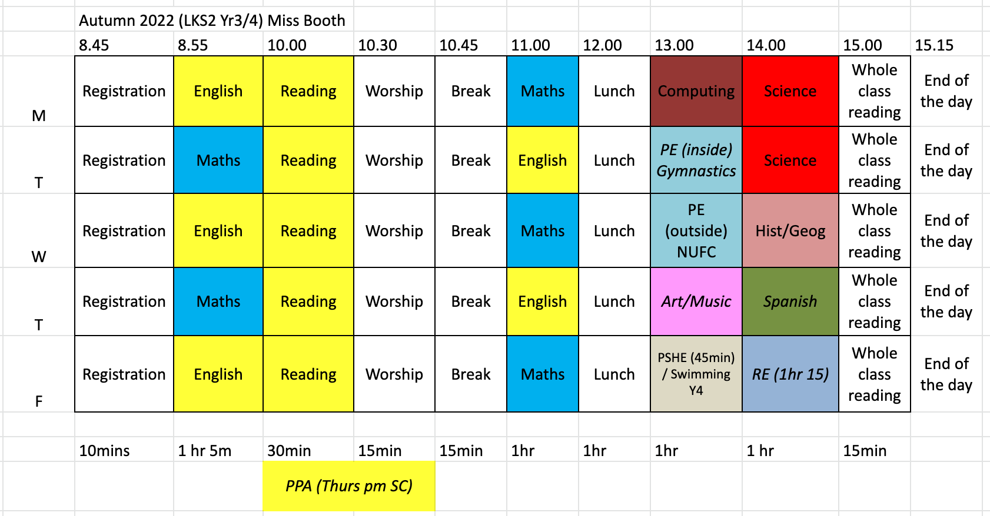
Our class timetable
In Maths we are learning about place value.
In Science we are learning about Rocks.
In History we are learning about the stone age to the iron age
Children will be receiving violin lessons as part of music this year.

Slide 7
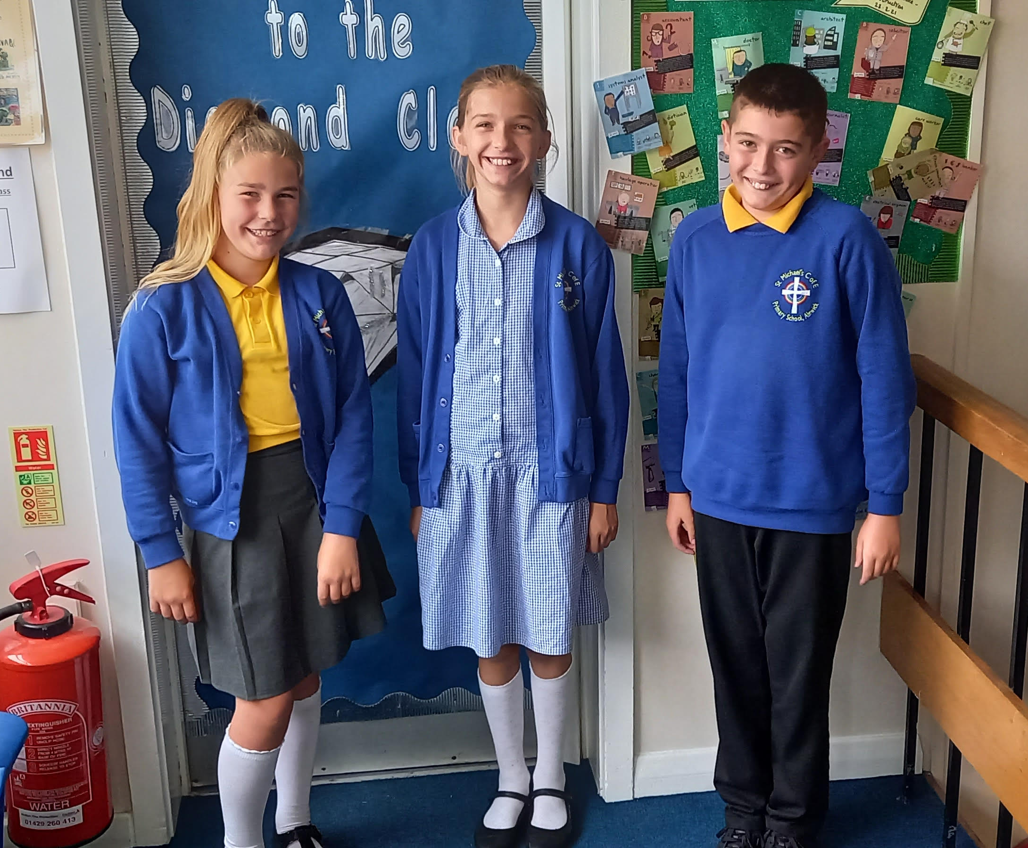
Uniform
Smart school uniform sets the tone for a day of learning.
Summer dresses can be worn whilst weather is still pleasant.
Bottoms should be grey or black.
School jumper/cardigan does not need to have school logo.

Slide 8
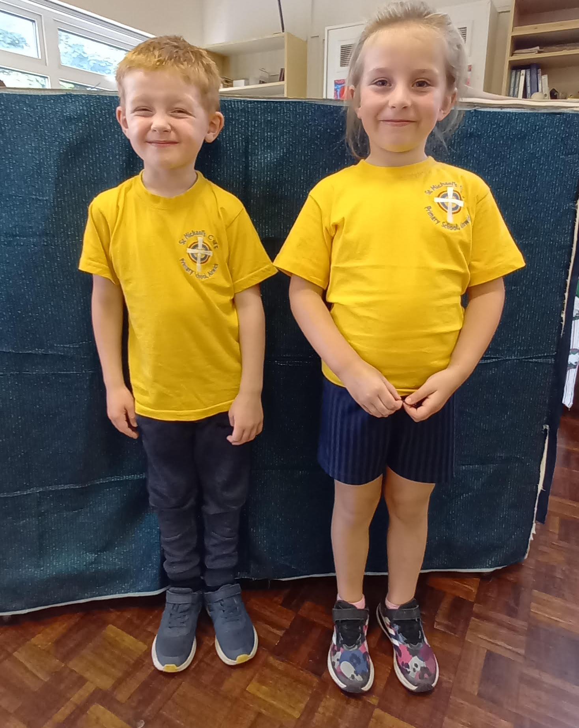
PE – Physical education
PE is part of the National Curriculum.
Our PE days are Tuesdays and Wednesdays.
This term both lessons are being delivered by Newcastle United foundation.
Children are to come in their PE kits for the day.
Children can wear tracksuit bottoms and jumpers if it is cold.
Other clothing is not allowed.
Year 4 children will have 1 swimming lesson each week for the whole year. Year 3 will be joining Year 4 for this lesson after Christmas.
PE kit MUST be a yellow top with blue/navy bottoms

Slide 9


We are a reading School!
Our ambition is for every child to read by 7 using a synthetic phonics approach and to develop a love of reading for fluency and comprehension in order to access a broad and balanced curriculum. We do everything to make this happen.

Slide 10
RWInc – our method to teach phonics
Reading
When using RWI to read the children will:
Learn 44 sounds and the corresponding letter/letter groups using simple prompts
Learn to read words using sound blending (Fred talk)
Read lively stories featuring words they have learnt to sound out
Show that they comprehend the stories by answering 'Find It' and 'Prove It’
Mrs Carr is our reading leader.
Children will read every day in school and we expect them to read every day at home, reading records will be checked every morning.

Slide 11
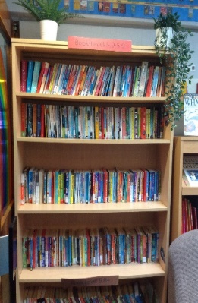
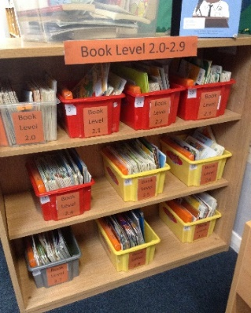
Accelerated reader – a love of reading
What is Accelerated Reader?
Accelerated Reader is a computer program that helps teachers and librarians manage and monitor children’s independent reading practice. Your child picks a book at their own level and reads it at their own pace. When finished, your child takes a short quiz on the computer. (Passing the quiz is an indication that your child understood what was read.) Accelerated Reader gives children and teachers feedback based on the quiz results, which the teacher then uses to help your child set goals and direct ongoing reading practice

Slide 12
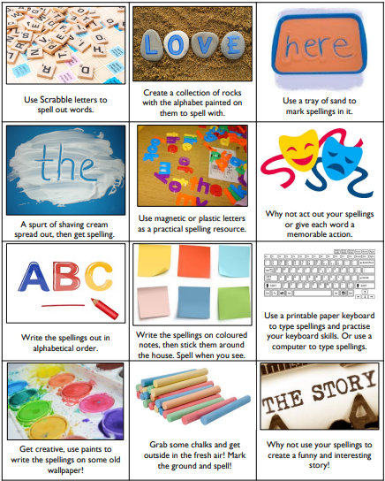
Spellings – earn 200 points from the menu!
50 point spelling activities:
Rainbow words: copy your spellings at least three times in different colours
Draw your words: draw and label each of your spellings
ABC words: write your words in alphabetical order
Silly sentences: write a ‘silly’ sentence for each of your words
Poem spellings: write a poem with at least 5 of your words
Colourful words: write your spellings with one colour for vowels and another for consonants
Backwards words: write your spellings backwards
Highlight: write your spellings out and use a highlighter for the trickiest part of each word
CAPITALS: write your spellings in capital letters

Slide 13

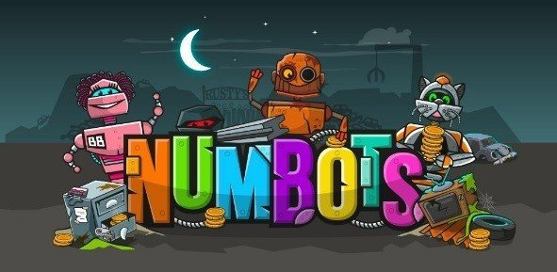
homework
Homework in KS1 and 2 consists of 3 parts:
  Daily reading
  Spelling
  Maths – Numbots or TTRockstars
  It is set on a Monday and ‘collected’ on a Friday.
  This sets good habits for moving on in education and the world of work.
  It is tightly focused on core learning – it helps to build perseverance.
  Children in year 4 will sit a times table test at the end of the school year which requires them to recall times table facts up to 12 x 12.

Slide 14
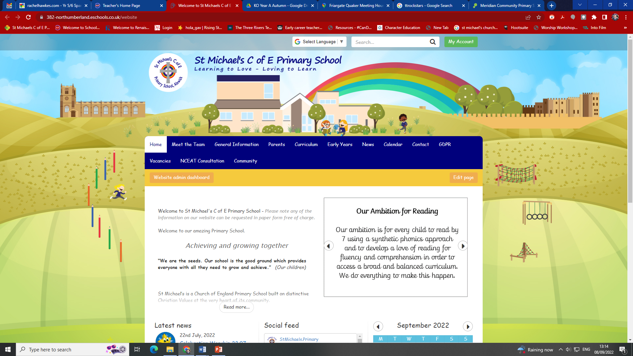
How to find out more
Our school website:
Ask us – we don’t bite!
Curriculum information and Knowledge Organisers: https://382-northumberland.eschools.co.uk/website/knowledge_organisers_autumn_term_2022_year_a_1/619123

Slide 15

If you need to talk to us…
We can pass on small pieces of information at the beginning of the day.
If you would like to talk more in-depth, please make an appointment with the office. We’re here to listen and address things as soon as possible.

