Slide 1
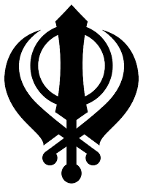
Sikhism

Slide 2
Khanda
The symbol or emblem of Sikhism is known as the Khanda. It is made up of: The Khanda - a double edged sword. This represents the belief in one God. The Chakkar, like the Kara it is a circle representing God without beginning or end and reminding Sikhs to remain within the rule of God.

Slide 3
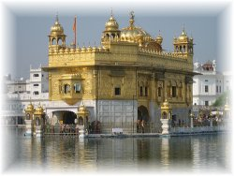
Gurdwara
Everyone sits crossed-legged on the floor of the Gurdwara. This is to show that everyone is equal.
Sikhs take their shoes off and wash their hands and feet before the enter.
At the end of the service everyone is invited to Langar hall to share a meal.
People from any religion or no religion can join in the service and share the meal.

Slide 4
Guru Granth Sahib

Slide 5
Guru Granth Sahib
Guru Granth Sahib contains hymns and teachings written by the Gurus and other holy men.
It is kept on a raised place called a Manji . It is kept there so that everyone can see and read it.
When it is not in use it may be covered by a cloth called rumalla.
A fan called a chor is waved over the Guru Granth Sahib as a sign of respect.

Slide 6
The Five Ks
Sikhs wear five symbols of their faith these are called The Five Ks.
Kesh is the word for long uncut hair and beard.
Sikhs comb their hair with a Kangha.
They also wear special cotton shorts called Kacha.
Kirpan is a short sword the is the symbol of their fight against evil.
The Kara is a steel bangle that they wear all the time.

Slide 7
The Five Ks

Slide 8
Special festivals
One of the most important festivals is Baisakhi
On this day Sikhs remember Khalsa was created and the Sikhs were given the Five Ks.
Sikhs also celebrate Diwali. Lamps are lit outside the Gurdwaras .
Hola Mahalla is a festival when Sikhs show off their fighting skills, there is a parade and mock battles.

