Slide 1
Judaism
Fact book all about

Slide 2
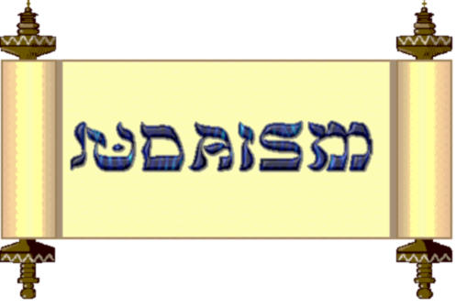
The Torah scroll

Slide 3
The holiest book for the Jews is the Hebrew bible. It contains the Torah( five books of Moses)
The words of the Torah are hand written on scrolls in Hebrew. This is the ancient language of the Jews.
When a copy of the Torah becomes too old to read it is not thrown away it is buried as a mark of respect.
The Torah scrolls are kept in a special cupboard called the Ark.

Slide 4
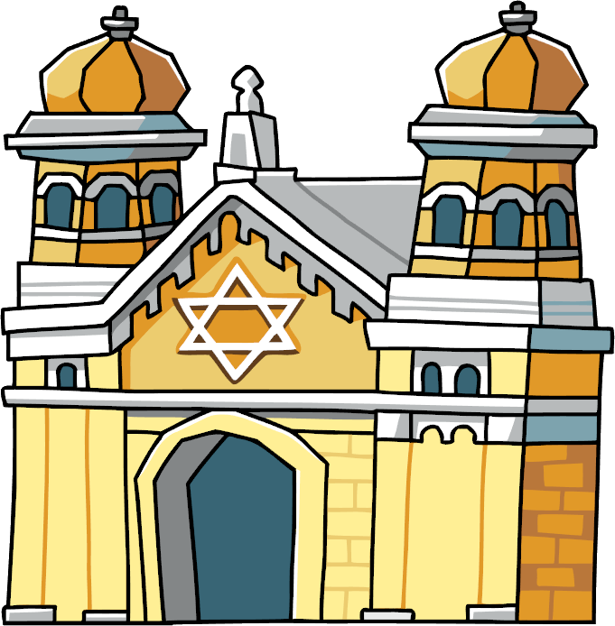
Synagogue

Slide 5
Synagogue
A building which Jews meet to worship and study.
They wear prayer shawls called Tallets when praying.
They pray and sing songs
On Shabbat , The Torah is read in the synagogue.
The holy person is called a Rabbi

Slide 6
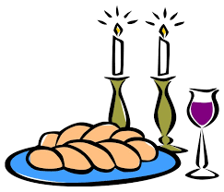
Shabbat

Slide 7
Shabbat
Shabbat is the Jewish holy day of rest and prayer.
On Friday nights Jews celebrate the start of Shabbat which lasts from Friday evening to Saturday night.
No work or jobs are done during Shabbat. It is for family.

Slide 8
Shabbat
Jews celebrate Shabbat with special bread called Challah
At the end of Shabbat there is a ceremony called Havdalah. Blessings are said over a glass of wine( or juice if you are young!), a box of spices and a special plaited candle.
Everyone sniffs the spices to carry the sweetness of Shabbat into the next week with them.

Slide 9
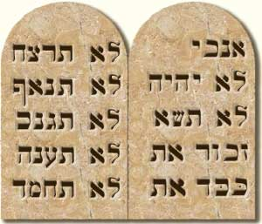
10 Commandments
Jewish people believe that the Ten Commandments are ten rules which God gave to the Jews, so that they could live good lives.

Slide 10
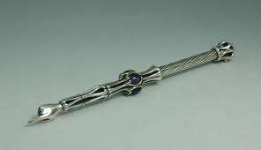
Yad
Yad is a pointer that looks like a hand and is used when reading the Torah

Slide 11
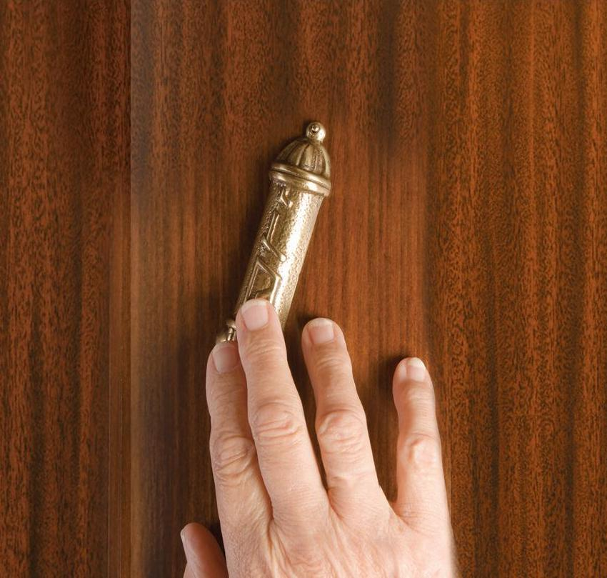
Mezuzah

Slide 12
Mezuzah
Mezuzah means doorpost
A mezuzah is fixed to the right hand side of the front door in a Jewish home.

Slide 13
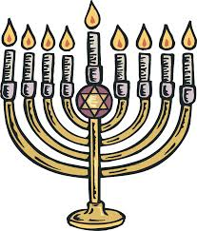
Menorah
The Menorah is a Jewish symbol
It is a candlestick that holds seven candles.

Slide 14
Jewish Festivals
Pesach is the Jewish word for Passover
Yom Kippur is the last day of the festival of Rosh Hashanah. It is the holiest day of the year.

