Slide 1
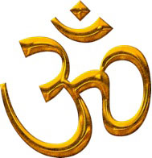
Hinduism

Slide 2
Om
This is the Om symbol. It is often used as the sign of Hinduism. Om is also a scared sound which Hindus say at the beginning and end of prayers.

Slide 3
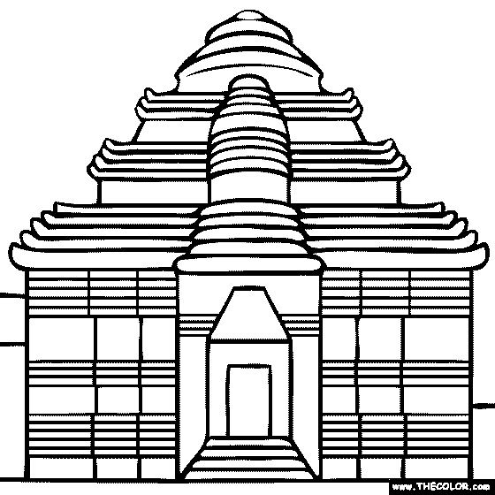
Mandir
Many Hindus worship in a place called a Mandir.
Mandir in English means temple.
The Hindu word for worship is puja
Hindus bring offerings and in return they hope to receive a blessing from the lord.

Slide 4
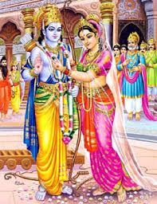
Ramayana
The Ramayana is the holy book for Hindus.
It tells the story of Rama and Sita
Most Hindu holy books were written in an ancient language called Sanskrit.
Hindu priests study them and explain their meaning.

Slide 5
Hindu Gods
There are many Hindu gods
One of the most popular is Krishna – he is a teacher and warrior.
Shakti – she is usually gentle and kind but can be fierce. In her fierce form she is called Durga. She rides on a tiger.
Lakshmi is the goddess of good luck and wealth.
Ganesh is the elephant headed god who is worshipped if Hindus are starting anything new.

Slide 6
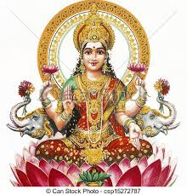
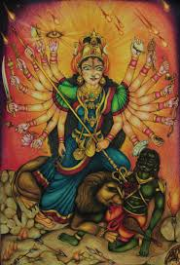
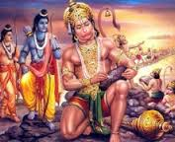
Hindu Gods

Slide 7
Hindu Festivals
There are many Hindu festivals.
Diwali – festival of lights is the most important festival to Hindus. It celebrates Rama and Sita coming home from the forest and also Lakshmi into their homes.
Holi is the festival of colours. As part of the fun people throw bright coloured powder over each other .
Raksha Bandhan is for brothers and sisters. Brothers promise to love and care for their sisters.

Slide 8
Hindus
When Hindus greet each other they put their palms together and say Namaste. It means my respects to you.
Rangoli are very colourful and bright patterns that are used to decorate homes during Diwali.
Tilak is a mark put on the forehead. It is made of ash or special red powder.

