Slide 1
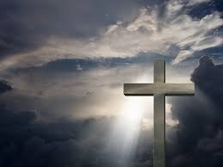
Christianity
Fact book all about

Slide 2
The Cross
The cross is the symbol for Christianity.

Slide 3
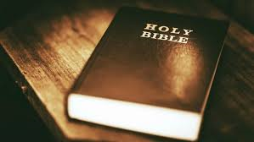
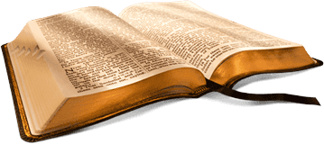
The Bible

Slide 4
The bible is a holy book for Christians.
It teaches them about God and tells them about Jesus’s life
It has two parts
The first is the Old Testament which was written before Jesus was born.
The second is called the New Testament – this is all about Jesus's life and his teachings.
The bible contains lots of stories called parables

Slide 5
The Church

Slide 6
Inside a church
Altar- the table used for Eucharist.
Font – is a large bowl that holds holy water (blessed)
Pulpit – raised platform where the vicar will give his/her sermon.
Lectern - is where the Bible is kept. They are often in the shape of an eagle( this is to show that the Word of God is carried around the world).
Pews- where the congregation sit.

Slide 7
The Church
This is the place where Christians go to worship God.
Most churches have a cross on top or outside
The holy person for Christians is called a vicar.
The vicar leads the service in church which includes prayers, hymns and a sermon ( tells us what Jesus's teachings mean).
The vicar will give the sermon from a pulpit.

Slide 8
The Church
The most important part of a church is the altar ( special raised table with candles, crosses and flowers on).
Children can go to Sunday School to learn about the stories of Jesus.
In church there are special services like Holy Communion. This is where Christians share a small piece of bread and some wine to remember that Jesus died on the cross.

Slide 9
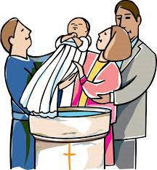
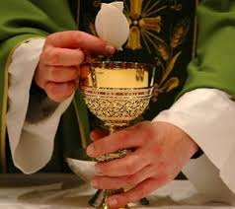
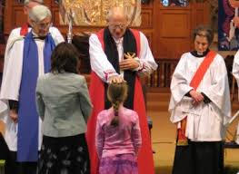
Special services

Slide 10
Special Services
Confirmation- this is when a Christian promises to follow the teachings of Jesus.
Eucharist- is another word for the Holy Communion service.
Baptism- this where a Christian is sprinkled or bathed in water to become a member of the church.

Slide 11
Christian Festivals
Easter is the most important festival.
Holy week- this is the week that leads up to Easter. It is when Christians remember that Jesus was crucified and then came back to life.
On Good Friday Christians remember that Jesus was Crucified on a cross
Easter Sunday- this is a happy day as Christians remember that Jesus came back to life.

Slide 12
Christian Festivals
Christmas is when Christians celebrate the birth of Jesus.
Many children dress up and act out the story of Jesus's birth with a play. It is called a nativity.
Harvest Festival- is a service that Christians give thanks to God for all the good things that God have given them. During the service food is collected and then sent to people who are in need.

Slide 13
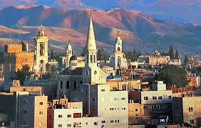
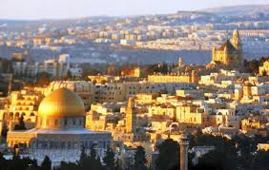
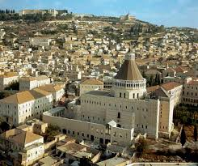
Holy places

Slide 14
Holy places
There are many holy places to Christians.
Bethlehem this is where Jesus was born.
Nazareth this is where Jesus grew up
Jerusalem this is where Jesus was Buried .
Christians make pilgrimages to all of these places.

