Slide 1

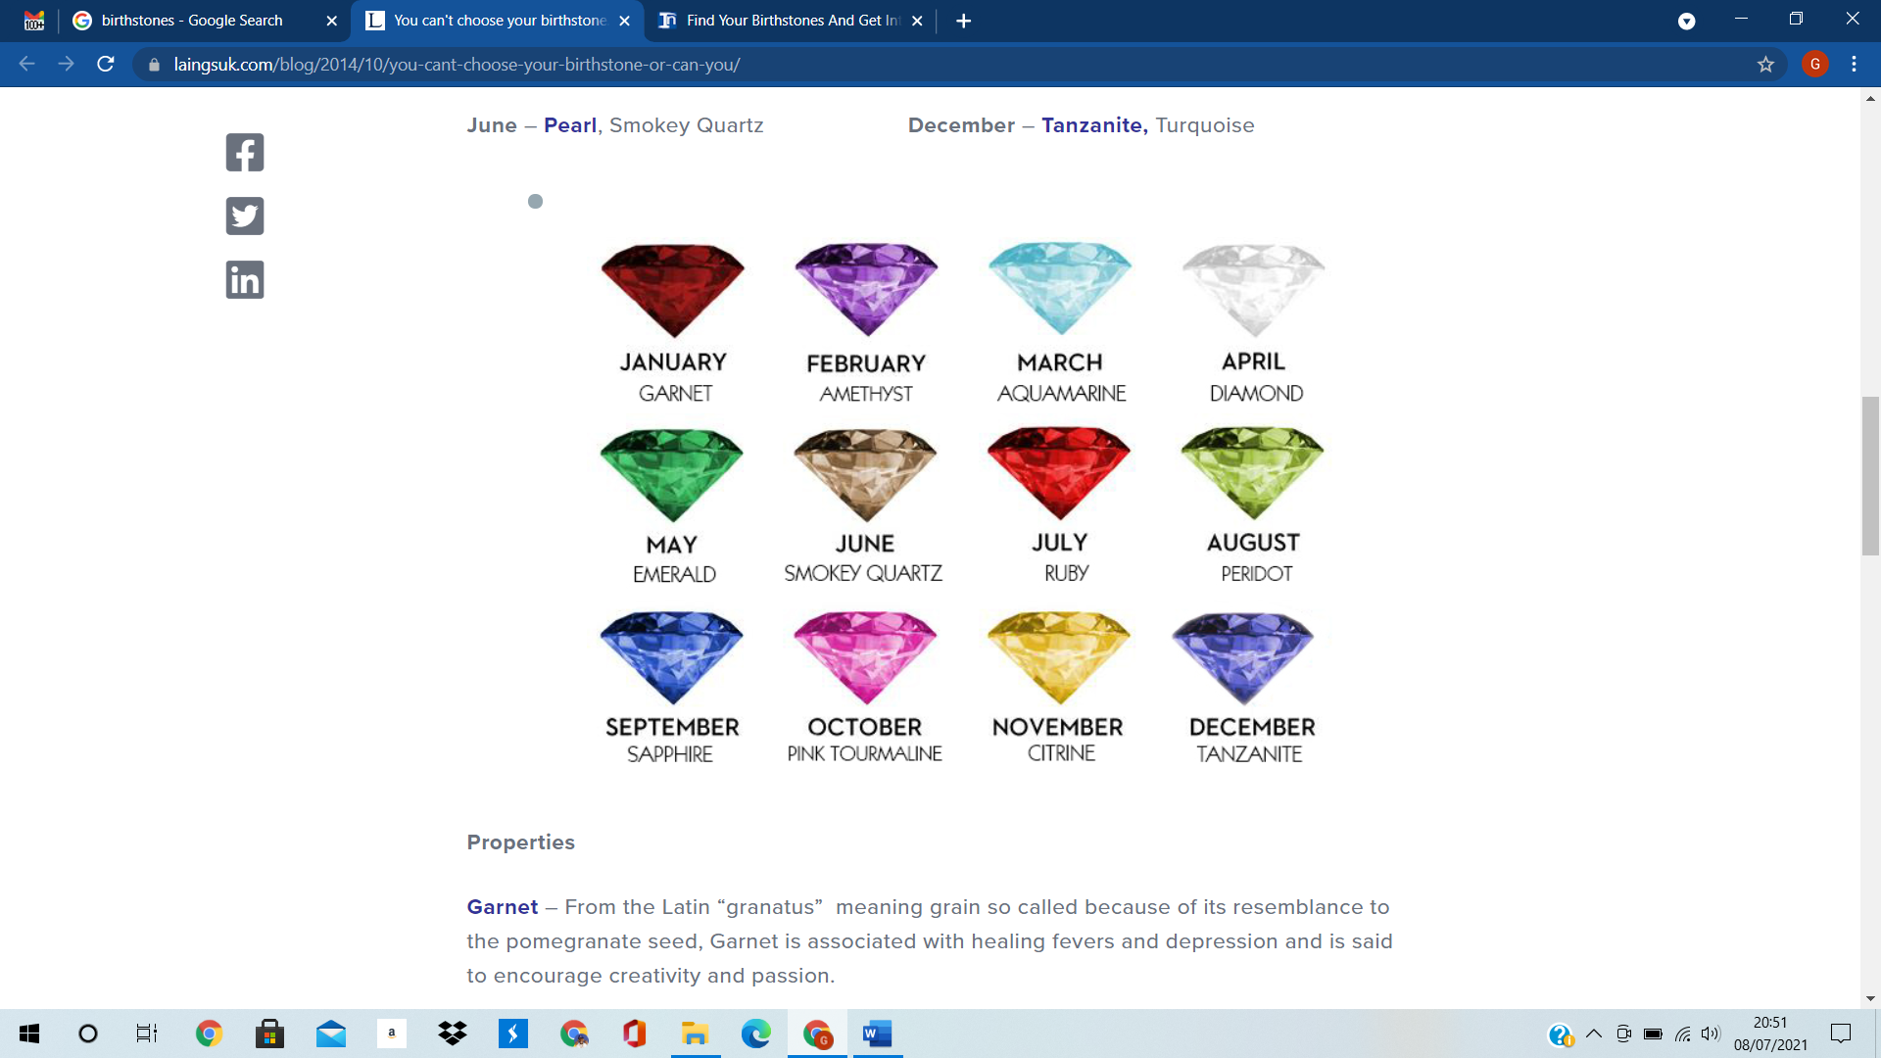
Welcome to the AMETHYST Class

Slide 2
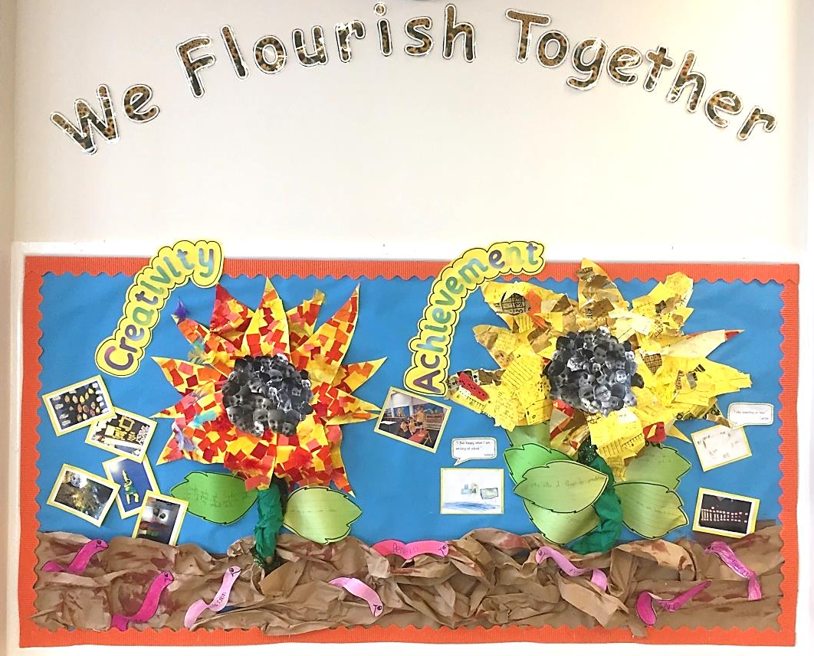
Our vision:
Achieving and growing together

Slide 3
Respect
Perseverance
Achievement
Notes:
A curriculum equation

Slide 4
School rules
Keep hand, feet and objects to ourselves
Use quiet, calm voices (no bad language)
Always follow teacher instructions
Care for the school environment

Slide 5
Attendance and punctuality
School begins at 8.45am for all children
Breakfast clubs runs from 7.30am if needed
Children should be at school every day and on time
Good attendance and punctuality sets good habits for the future.

Slide 6
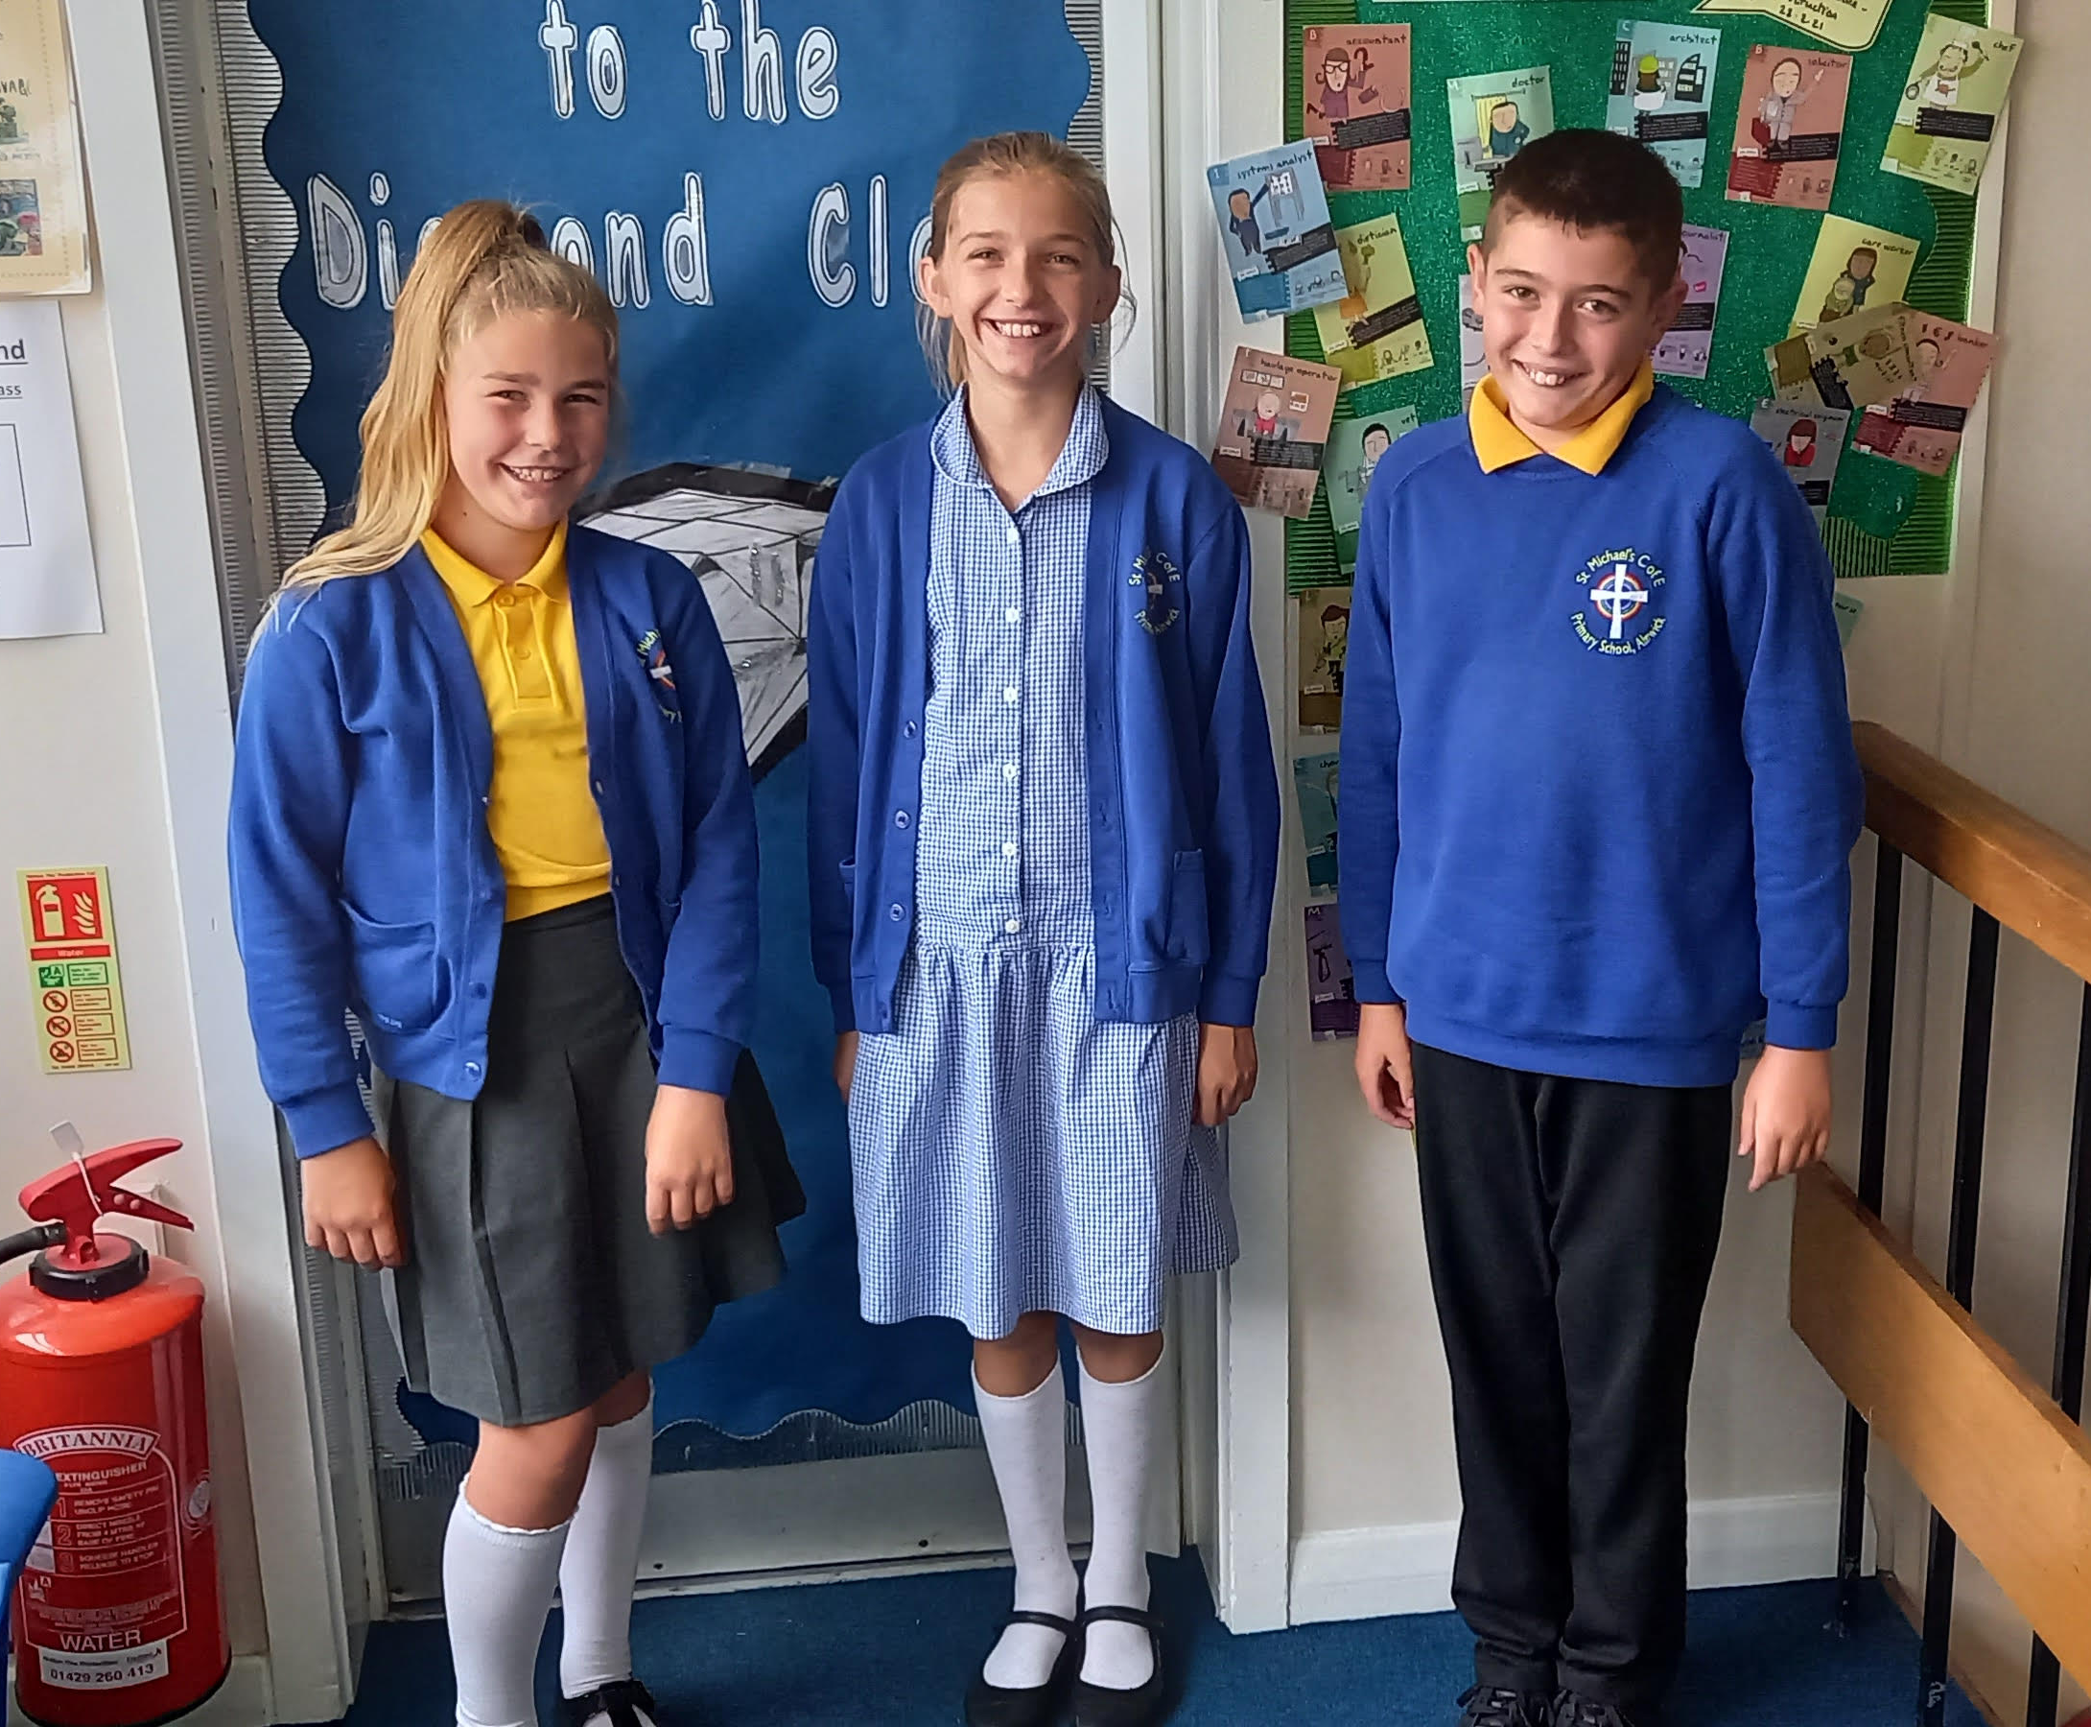
Uniform
Smart school uniform sets the tone for a day of learning.

Slide 7
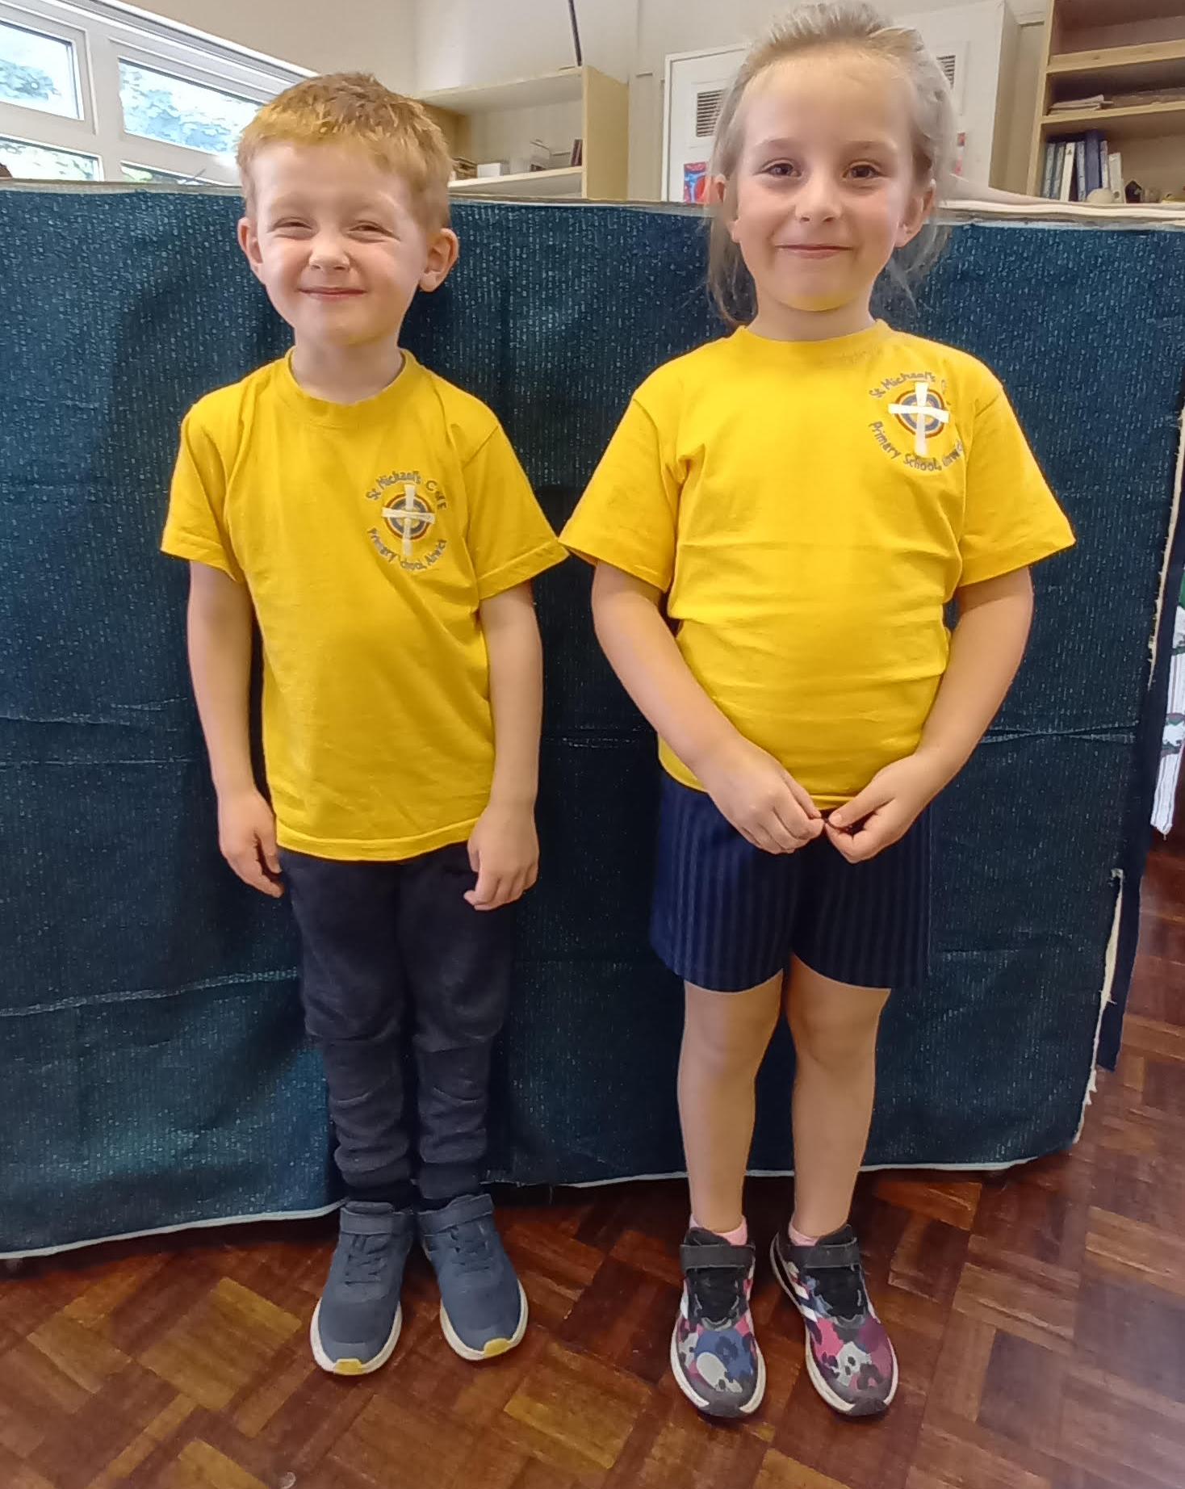
PE – Physical education
PE is part of the National Curriculum.
Our PE days are Wednesday and Friday.
Children are to come in their PE kits for the day.
Children can wear tracksuit bottoms and jumpers if it is cold.
Other clothing is not allowed.
(Swimming kit and days / costs)
After school club this half term is football with NUFC. Runs from 3.15-4.15 and costs £2 per session payable through school money.

Slide 8


We are a reading School!
Our ambition is for every child to read by 7 using a synthetic phonics approach and to develop a love of reading for fluency and comprehension in order to access a broad and balanced curriculum. We do everything to make this happen.

Slide 9
RWInc – our method to teach phonics
Reading
When using RWI to read the children will:
Learn 44 sounds and the corresponding letter/letter groups using simple prompts
Learn to read words using sound blending (Fred talk)
Read lively stories featuring words they have learnt to sound out
Show that they comprehend the stories by answering 'Find It' and 'Prove It’
Mrs Carr is our reading leader.
Children will read every day in school and we expect them to read every day at home.

Slide 10
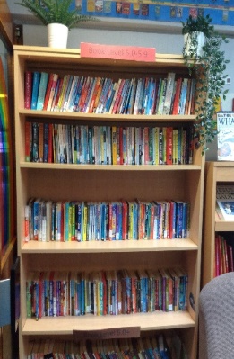
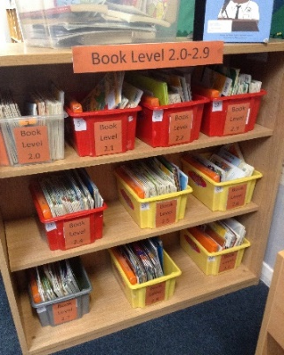
Accelerated reader – a love of reading
What is Accelerated Reader?
Accelerated Reader is a computer program that helps teachers and librarians manage and monitor children’s independent reading practice. Your child picks a book at their own level and reads it at their own pace. When finished, your child takes a short quiz on the computer. (Passing the quiz is an indication that your child understood what was read.) Accelerated Reader gives children and teachers feedback based on the quiz results, which the teacher then uses to help your child set goals and direct ongoing reading practice

Slide 11
Spellings – earn 200 points from the menu!
50 point spelling activities:
Rainbow words: copy your spellings at least three times in different colours
Draw your words: draw and label each of your spellings
ABC words: write your words in alphabetical order
Silly sentences: write a ‘silly’ sentence for each of your words
Poem spellings: write a poem with at least 5 of your words
Colourful words: write your spellings with one colour for vowels and another for consonants
Backwards words: write your spellings backwards
Highlight: write your spellings out and use a highlighter for the trickiest part of each word
CAPITALS: write your spellings in capital letters

Slide 12


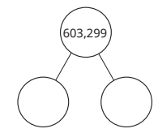
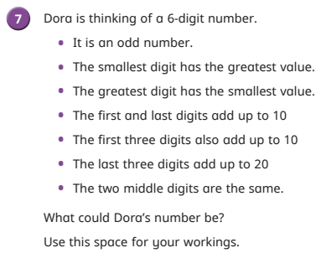
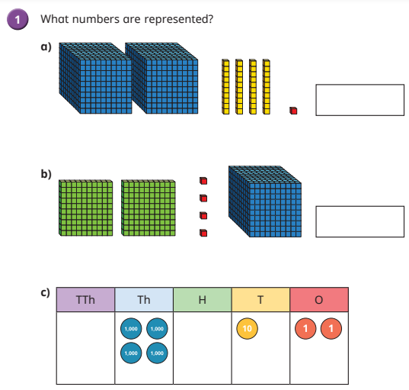
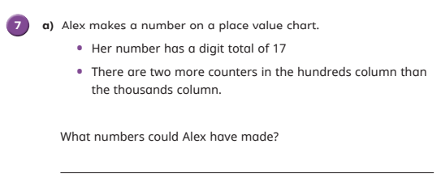
Maths
White Rose Maths
Made of three main parts:
Fluency
Reasoning
Problem Solving
Daily arithmetic session
A BIG focus on fractions
Times table knowledge is imperative
Support school by encouraging TTR

Slide 13


homework
Homework consists of 3 parts:
  Daily reading
  Spelling
  Maths – Numbots or TTRockstars
  It is set on a Monday and ‘collected’ on a Friday.
  This sets good habits for moving on in education and the world of work.
  It is tightly focused on core learning – it helps to build perseverance.

Slide 14
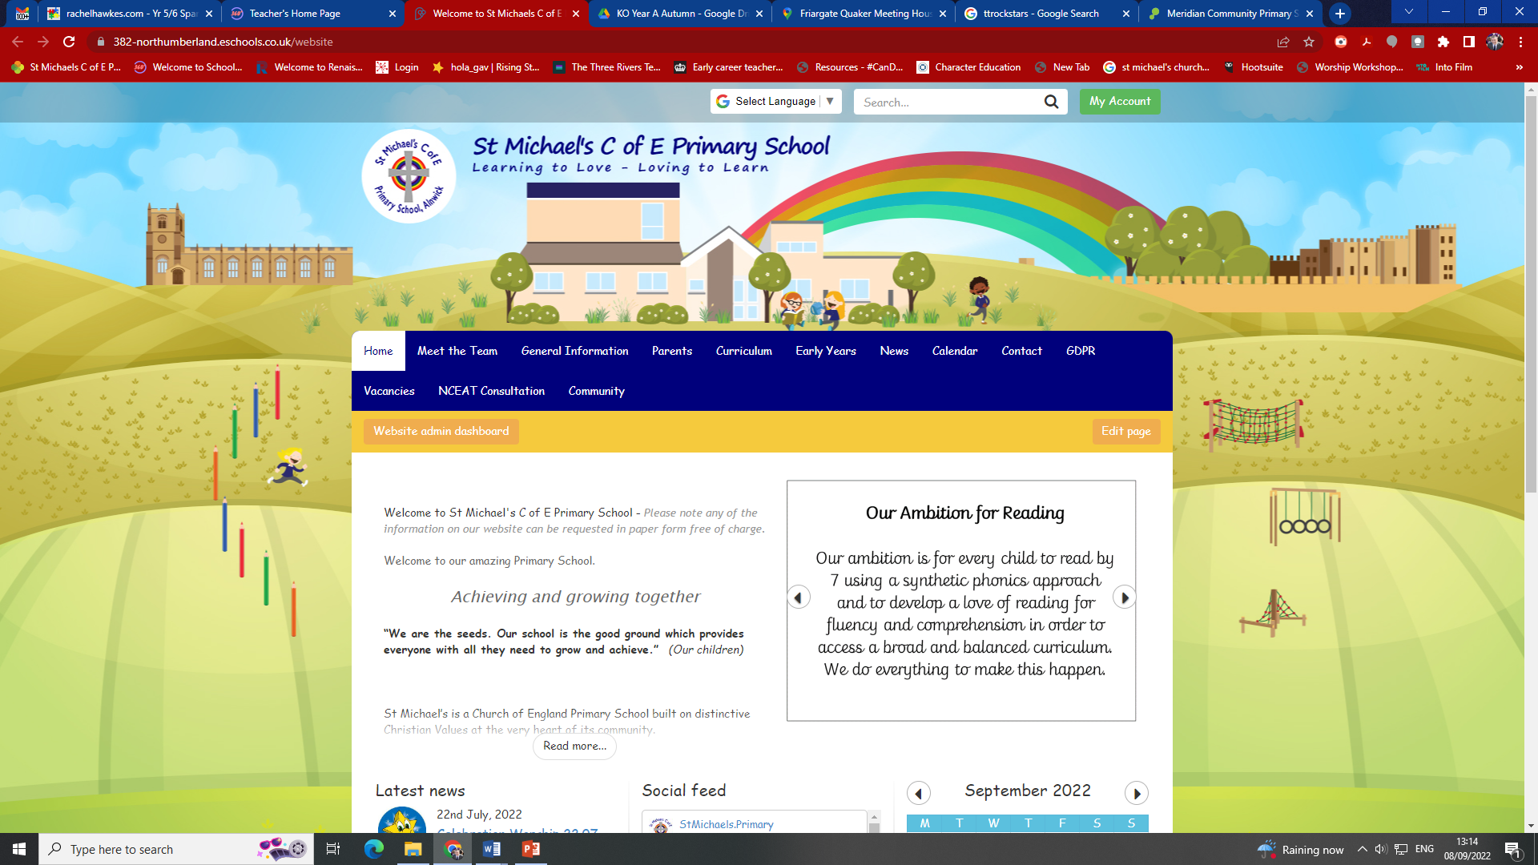
How to find out more
Our school website:
Ask us – we don’t bite!
Curriculum information and Knowledge Organisers: https://382-northumberland.eschools.co.uk/website/knowledge_organisers_autumn_term_2022_year_a_1/619123
Ask us – we don’t bite!

Slide 15

If you need to talk to us…
We can pass on small pieces of information at the beginning of the day.
If you would like to talk more in-depth, please make an appointment with the office. We’re here to listen and address things as soon as possible.

